Slide 1



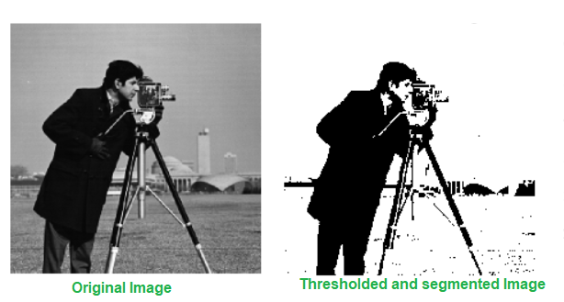
Session 3 :
Introduction to Thresholding & Segmentation

Slide 2
Introduction
Image segmentation separates regions of interest (ROI) from the background.
Used in medical imaging, document analysis, and industrial automation.

Slide 3
Learning Outcome
Understand how to segment objects using binary and adaptive thresholding.
Learn preprocessing techniques that enhance segmentation accuracy.

Slide 4
Programming Task Overview
Use OpenCV to apply both binary and adaptive thresholding.
Generate masks that isolate foreground objects from varied backgrounds.

Slide 5
Why It Matters
Thresholding helps in removing noise, isolating targets, and improving recognition.
Applications:
- Medical imaging: Tumor detection
- OCR: Text isolation
- Surveillance: Motion area segmentation

Slide 6
Real-World Example
Scenario 1: Extracting handwritten notes from scanned exam papers.
Scenario 2: Segmenting lesions in retinal fundus images.

Slide 7
Understanding Thresholding Techniques
Binary Thresholding: Uses a global fixed value.
Adaptive Thresholding: Calculates local thresholds per region.
Adaptive is better for non-uniform lighting.

Slide 8
Implementing Binary Thresholding
Use: cv2.threshold(image, threshold_value, max_value, type)
Best for: Evenly lit images
Output: Binary image (object vs background)

Slide 9
Using Adaptive Thresholding
Use: cv2.adaptiveThreshold(...)
Types: ADAPTIVE_THRESH_MEAN_C or GAUSSIAN_C
Best for: Uneven lighting, natural scenes

Slide 10
Preprocessing Before Thresholding
Convert image to grayscale
Apply Gaussian blur
Benefits:
- Removes noise
- Improves segmentation accuracy

Slide 11
Evaluating Results
Display original vs binary vs adaptive threshold using Matplotlib
Compare effectiveness visually
Determine which method isolates objects better

Slide 12
Python Code:
Thresholding & Segmentation
Project Title: Adaptive Object Segmentation with Noise Reduction
Objective: Segment objects using multiple thresholding techniques, incorporating noise reduction for robustness.

Slide 13
Image Loading and Noise Reduction
- Load grayscale image using cv2.imread with cv2.IMREAD_GRAYSCALE
- Apply Gaussian Blur (5x5 kernel) using cv2.GaussianBlur to reduce noise and improve thresholding accuracy

Slide 14
Binary and Adaptive Thresholding
- Binary Threshold: Use cv2.threshold with a real-time adjustable threshold via trackbar
- Adaptive Threshold: Apply cv2.adaptiveThreshold using Gaussian method with block size 11 and constant 2

Slide 15
Morphological Operations and Visualization
- Use cv2.morphologyEx with a closing operation (5x5 kernel) to enhance segmentation
- Display original, binary, and adaptive thresholded images side-by-side using cv2.hconcat

Slide 16
Interactive Loop and Code Snippet
- Use OpenCV trackbars for real-time control and cv2.imshow for live updates
- Exit display with 'q' key
Code Highlights: cv2.threshold(...), cv2.adaptiveThreshold(...), cv2.morphologyEx(...)

Slide 17

Python Script on Thresholding & Segmentation
PART 1
import cv2
import numpy as np
def nothing(x):
pass
image = cv2.imread('image.jpg', cv2.IMREAD_GRAYSCALE)
if image is None:
raise ValueError("Image not found!")
blurred = cv2.GaussianBlur(image, (5, 5), 0)

Slide 18
Python Script on Thresholding & Segmentation
PART 2
cv2.namedWindow('Thresholding')
cv2.createTrackbar('Binary Thresh', 'Thresholding', 127, 255, nothing)

Slide 19
Python Script on Thresholding & Segmentation
PART 3
while True:
thresh_val = cv2.getTrackbarPos('Binary Thresh', 'Thresholding')
_, binary = cv2.threshold(blurred, thresh_val, 255, cv2.THRESH_BINARY)
adaptive = cv2.adaptiveThreshold(blurred, 255, cv2.ADAPTIVE_THRESH_GAUSSIAN_C, cv2.THRESH_BINARY, 11, 2)
kernel = np.ones((5,5), np.uint8)
binary = cv2.morphologyEx(binary, cv2.MORPH_CLOSE, kernel)
adaptive = cv2.morphologyEx(adaptive, cv2.MORPH_CLOSE, kernel)

Slide 20
Python Script on Thresholding & Segmentation
PART 4
combined = cv2.hconcat([image, binary, adaptive])
cv2.imshow('Thresholding', combined)
if cv2.waitKey(1) & 0xFF == ord('q'):
break
cv2.destroyAllWindows()

Slide 21
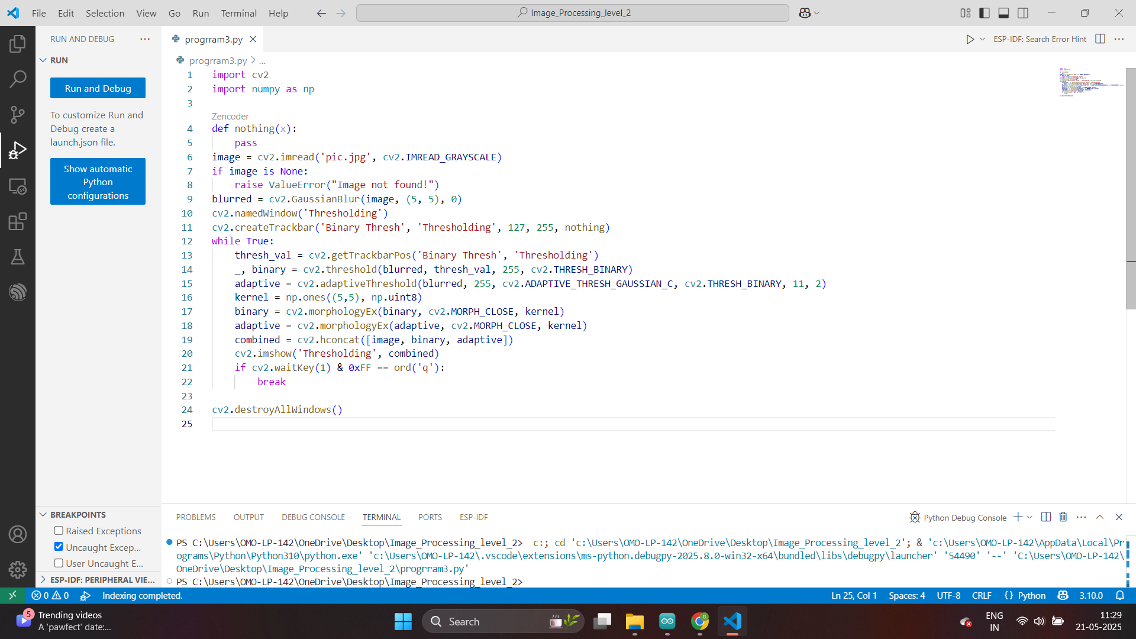

Slide 22
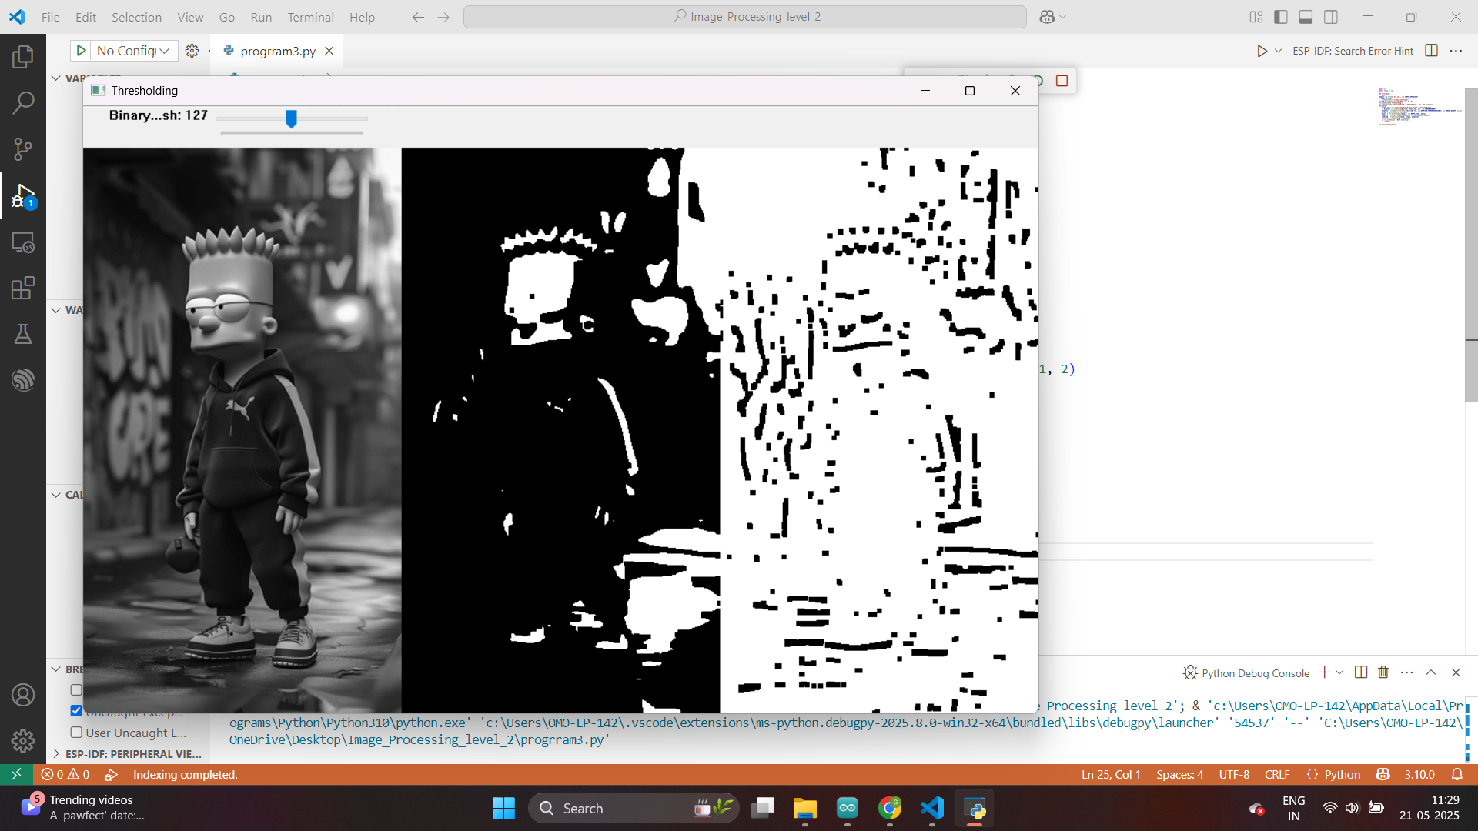

Slide 23

Python Script
Results
Video
Detailing
Various
Scenarios

Slide 24
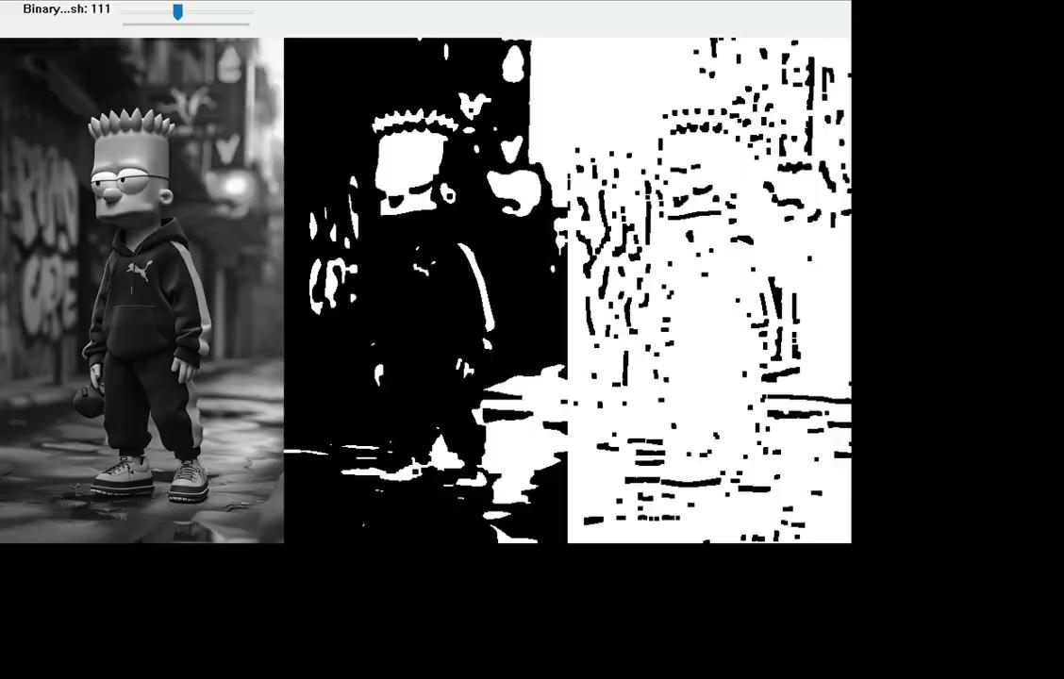

Slide 25
Exercise
1. What is the primary goal of image segmentation?
A. Compress image data
B. Detect edges
C. Separate regions of interest (ROI) from the background
D. Enhance image colors
Answer: C
2. Binary thresholding is most suitable for which type of images?
A. Blurry images
B. Noisy images
C. Images with uniform lighting
D. Colorful images
Answer: C

Slide 26
Exercise
3. Which OpenCV function is used for binary thresholding?
A. cv2.adaptiveThreshold
B. cv2.filter2D
C. cv2.threshold
D. cv2.Canny
Answer: C
4. Adaptive thresholding is preferred when the image has:
A. Uniform brightness
B. Color distortions
C. Uneven lighting
D. Very small dimensions
Answer: C

Slide 27
Exercise
5. What are the two common adaptive thresholding methods in OpenCV?
A. Sobel and Laplacian
B. Mean and Gaussian
C. Bilateral and Median
D. Fourier and Wavelet
Answer: B
6. Which preprocessing technique is used before thresholding to reduce noise? A. Dilation B. Grayscale conversion C. Gaussian blur D. Edge detection
Answer: C

Slide 28
Exercise
7. In adaptive thresholding, what does the “block size” parameter define? A. Image resolution B. Region over which threshold is calculated C. Size of output D. Frame rate
Answer: B
8. What type of morphological operation was applied to enhance segmentation results?
A. Erosion
B. Opening
C. Dilation
D. Closing
Answer: D

Slide 29
Exercise
9. Which function is used to apply morphological closing?
A. cv2.adaptiveThreshold
B. cv2.dilate
C. cv2.morphologyEx
D. cv2.bitwise_and
Answer: C
10. In the project example, how are the original and processed images visualized together?
A. Using subplot() from Matplotlib
B. Using a collage
C. Using cv2.hconcat
D. Using a separate GUI
Answer: C

